Slide 1
CLOUD COMPUTING
CHAPTER 13

Slide 2
CLOUD COMPUTING
An increasing trend in many organizations to move a substantial portion (or all) of their IT to cloud computing
NIST SP-800-145 defines cloud computing as: “A model for enabling ubiquitous, convenient, on-demand network access to a shared pool of configurable computing resources (e.g., networks, servers, storage, applications, and services) that can be rapidly provisioned and released with minimal management effort or service provider interaction. …”

Slide 3
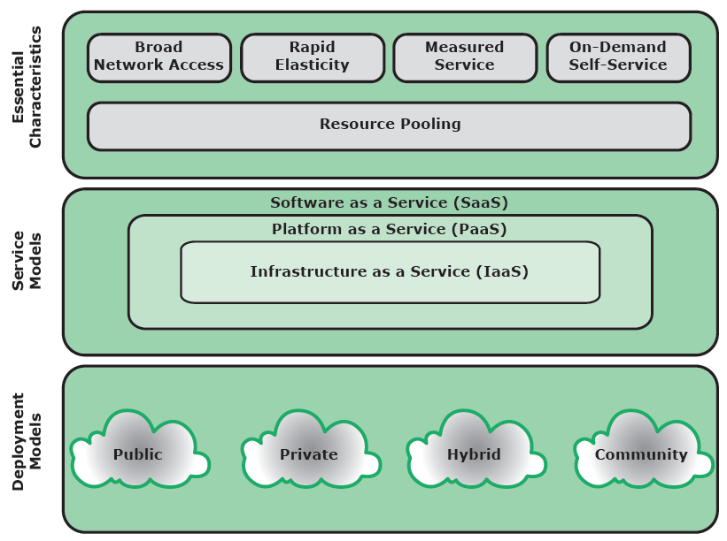
CLOUD COMPUTING ELEMENTS

Slide 4
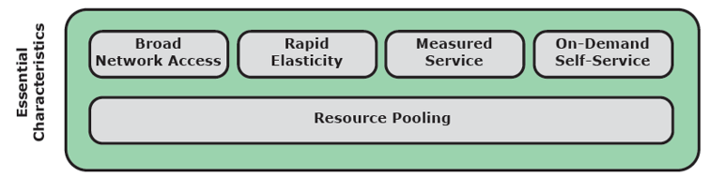
ESSENTIAL CHARACTERISTICS: BROAD NETWORK ACCESS
Capabilities available over a network
Accessed thru standard mechanisms
Use by heterogeneous client platforms (desktops, laptops, tablets, cell phones)

Slide 5
ESSENTIAL CHARACTERISTICS: RAPID ELASTICITY
The ability to expand/reduce services to specific requirements
Large numbers of servers during the holidays
Smaller number of resources during off-peak periods
Release a resource when a task is completed

Slide 6
ESSENTIAL CHARACTERISTICS: MEASURED SERVICE
Cloud system automatically
  Control and optimize resource use by leveraging a metering capability appropriate to the type of service
  Storage, processing, bandwidth, active users

Slide 7
ESSENTIAL CHARACTERISTICS: ON-DEMAND SERVICE
A consumer can unilaterally provision computing capabilities without requiring human interaction
  Server time, network storage
  Resources wont have to a permanent part of the client’s IT infrastructure

Slide 8
ESSENTIAL CHARACTERISTICS: RESOURCE POOLING
As a consequence of the above
The providers resources are pooled to serve multiple consumers using a multi-tenant model
Multiple resources assigned and re-assigned to clients
  Storage, processing power, bandwidth …
Consumers need not to know the physical location of the service

Slide 9
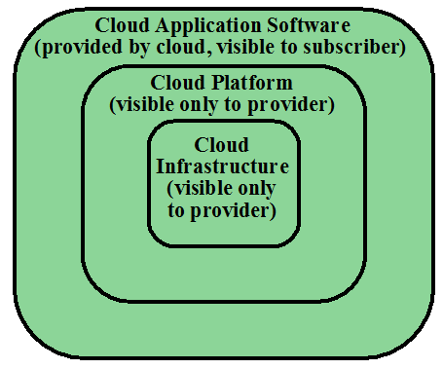
SERVICE MODEL: SAAS
Provides service to customers in the form of application software
Clients need not to install
Clients can access application via
various platforms thru a simple interface (often a browser).

Slide 10
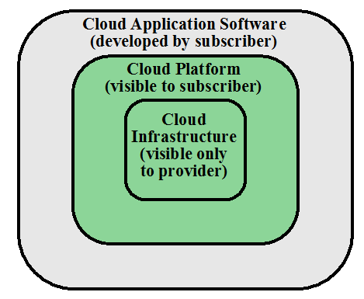
SERVICE MODEL: PAAS
Provides service to customers in the form of a platform on the which the customer apps can run
Clients deploy on the cloud
PaaS provides useful building block/tools

Slide 11
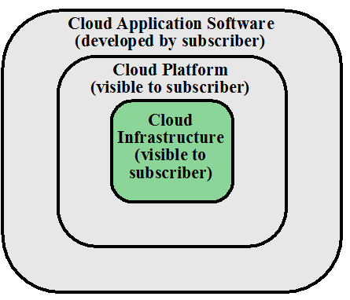
SERVICE MODEL: IAAS
Provides clients access to the underlying cloud infrastructure
VM and other abstracted hardware, OS, APIs
Amazon Elastic Computing (EC2) and Windows Azure

Slide 12
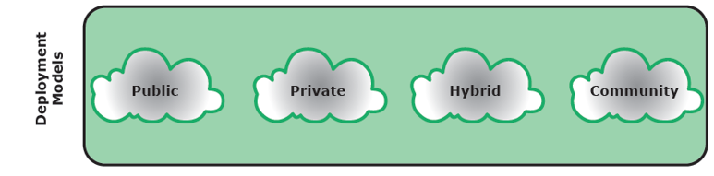
DEPLOYMENT MODELS
Public: the cloud resources/services are available to the general public
Private: The cloud infrastructure is solely for an organization
Community: the cloud infrastructure is for a specific community and is shared by several organizations
Hybrid: a composition two or more of the above

Slide 13

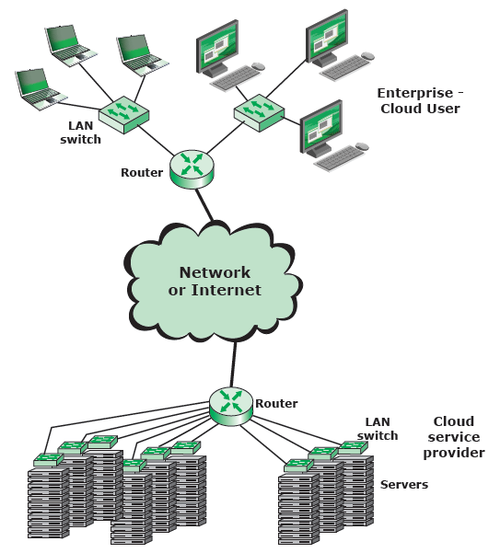
A TYPICAL CLOUD SERVICE CONTEXT

Slide 14
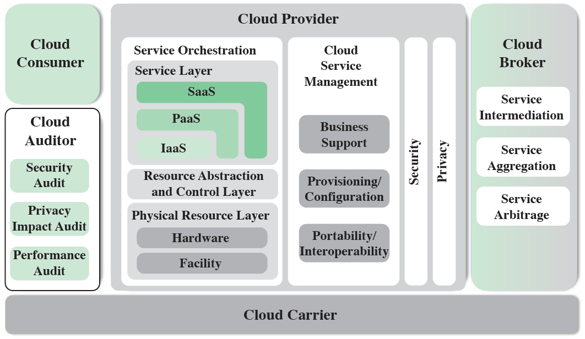
NIST’S REFERENCE ARCHITECTURE (CONCEPTUAL MODEL)

Slide 15
NIST’S REFERENCE ARCHITECTURE (CONCEPTUAL MODEL)
Cloud customer: A person or organization that uses or is interested in cloud providers services
Cloud provider (CP): a person or organization that makes cloud services available
Cloud auditor: A party that conducts independent assessment of sources (e.g., security)
Cloud broker: A party that manages use, performance,, negotiations
Cloud carrier: An intermediator that provides connectivity and service transport

Slide 16
CLOUD PROVIDER (CP)
For SaaS: CP deploys, configures, maintains, updates app software
For PaaS: CP manages the computing infrastructure for the platform (middleware, database, OS, programming languages, tools)
For IaaS: CP acquires physical computing resources: servers, network, storage, …

Slide 17
CLOUD SECURITY RISKS
Abuse and nefarious use of cloud computing
  Relatively easy to register for the services
  Many cloud services offer free trials
  Enables hackers to get inside to conduct attacks (spamming, DoS, …)
  The burden on CP to provide protection
Countermeasures
  Stricter/restrict registration
  Enhanced credit card monitoring
  Comprehensive monitoring (traffic)

Slide 18
CLOUD SECURITY RISKS
Insecure interfaces of APIs
  CPs expose a set of APIs for customers apps
  Security depends on APIs: must be secure (from authentication to encryption)
Countermeasures
  Analyzing the security of APIs
  Ensuring strong authentication and access control
  Understanding the dependency chair between the APIs

Slide 19
CLOUD SECURITY RISKS
Malicious insiders
  Client organization relinquishes many (or all) of its IT and gives to the CP
  A grave concern: malicious insider activity
Countermeasures (by client)
  Comprehensive supplier assessment
  Specify human resource requirements as part of legal contract
  Require transparency

Slide 20
CLOUD SECURITY RISKS
Shared technology issues
  IaaS services are delivered in a scalable way by a shared infrastructure (CPU caches, GPUs, …)
  Probably not designed for multi-tenant architecture
  Vulnerable to attacks (insider and outsiders)
Countermeasures
  Implement best security practices during implementation, deployment, configuration
  Monitor environment for unauthorized activities
  Promote strong authentication and access control

Slide 21
CLOUD SECURITY RISKS
Data loss or leakage
  Cloud storage may be the only backup storage
  Could be devastating for many clients if data is lost
Countermeasures
  Implement strong API access control
  Encrypt and protect integrity when in transit
  Analyze data protection at design and run time

Slide 22
CLOUD SECURITY RISKS
Account or service hijacking
  Usually with stolen credentials
  Compromise confidentiality, integrity and availability
Countermeasures
  Prohibit sharing of credentials between users
  Leverage strong multi-factory authentication
  Employ proactive monitoring

Slide 23
DATA PROTECTION IN THE CLOUD
Data must be secured while at transit, in use, or at rest
  Client can employ encryption for transit
  Client can encrypt data for storage (rest) but can also be CP’s responsibility (key management)

Slide 24
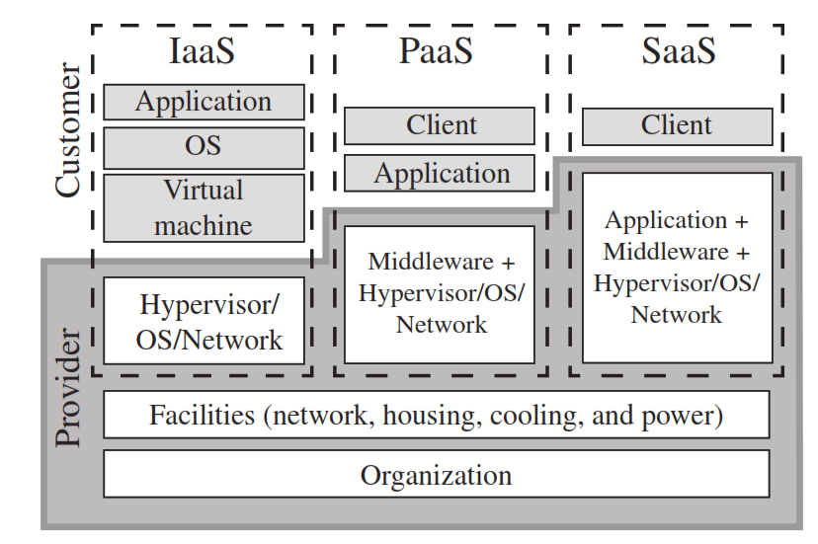
CLOUD SECURITY AS A SERVICE
Cloud security as a service (SecaaS,)
Security Considerations for Cloud Computing Assets
Cloud computing assets

Slide 25
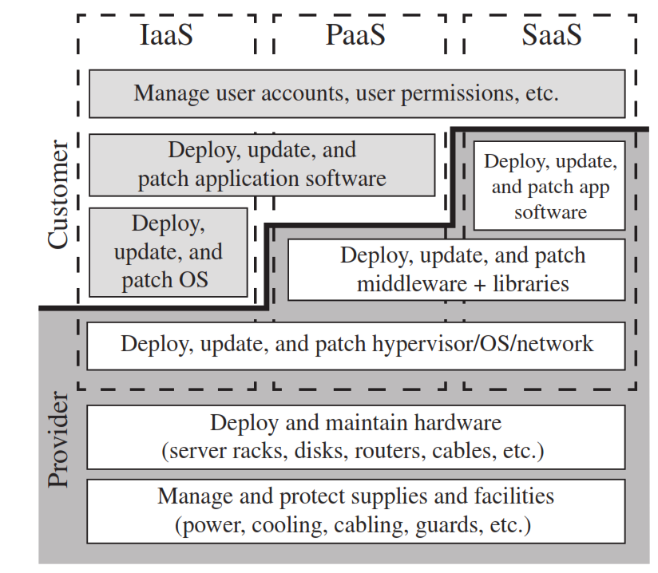
Security Considerations for Cloud Computing Assets
Cloud computing management tasks

Slide 26
SECAAS CATEGORIES OF SERVICE:
Identity and access management
Data loss prevention
Web security
E-mail security
Security assessments
Intrusion management
Security information and event management
Encryption
Business continuity and disaster recovery
Network security

Slide 27
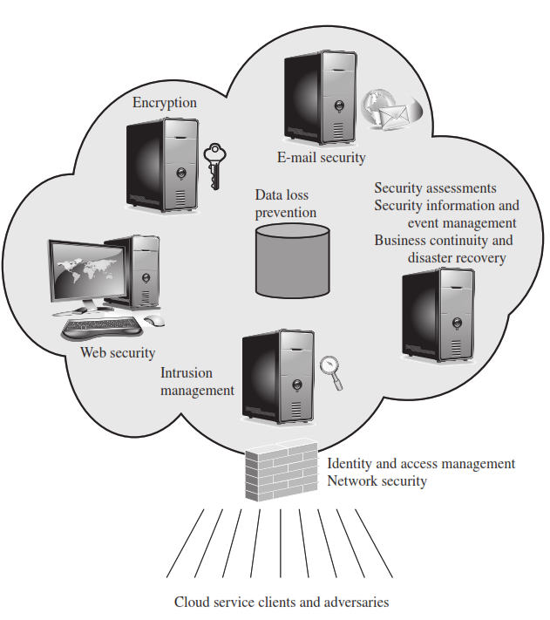
IDENTITY AND ACCESS MANAGEMENT (IAM)
People, Processes, and Systems.
Used to manage access to enterprise resources by:
  Assuring the identity of an entity is verified,
  Granting the correct level of access based on this
  assured identity.

Slide 28
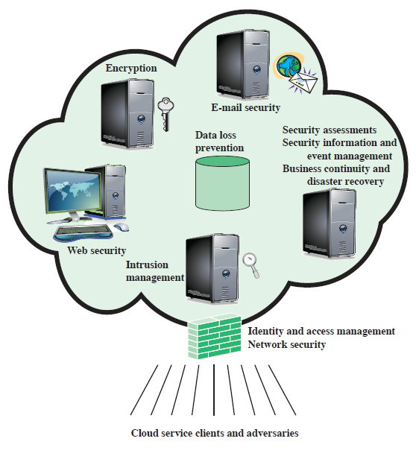
ELEMENTS OF CLOUD SECURITY AS A SERVICE
Data loss prevention (DLP)
Web security
E-mail security
Security assessments
Intrusion management
Security information and event management (SIEM)
Encryption
Business continuity and disaster recovery
Network security

Slide 29
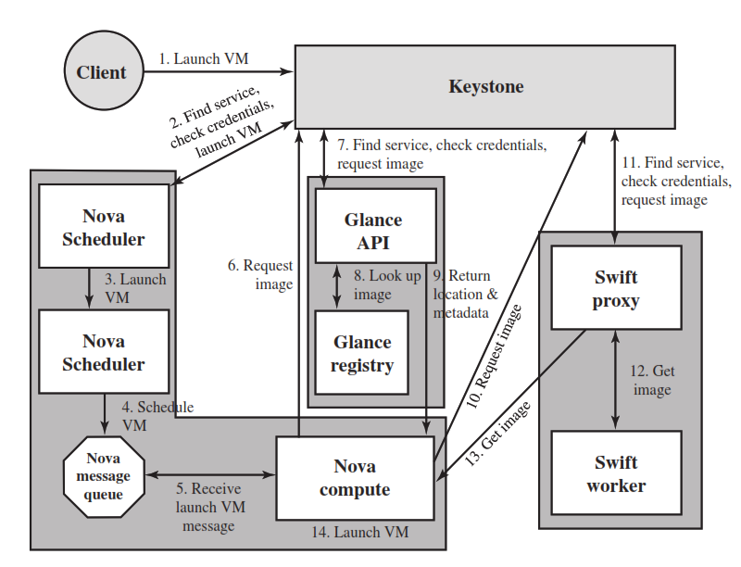
AN OPEN-SOURCE CLOUD SECURITY MODULE

Slide 30
SUMMARY
Introduced databases and DBMS
Relational databases
Database access control issues
  SQL, role-based
Inference
Statistical database security issues
Database encryption
Cloud security
Notes:
Chapter 5 summary.

